Slide 1

When Jesus was a Refugee

Slide 2
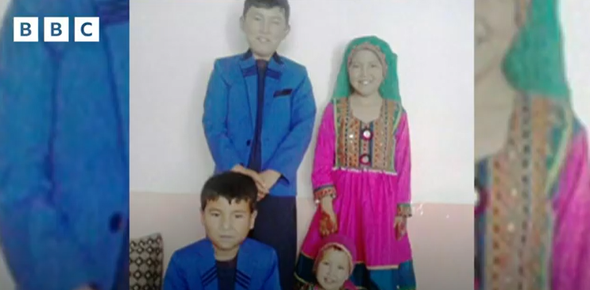
Ahmad's Story

Slide 3
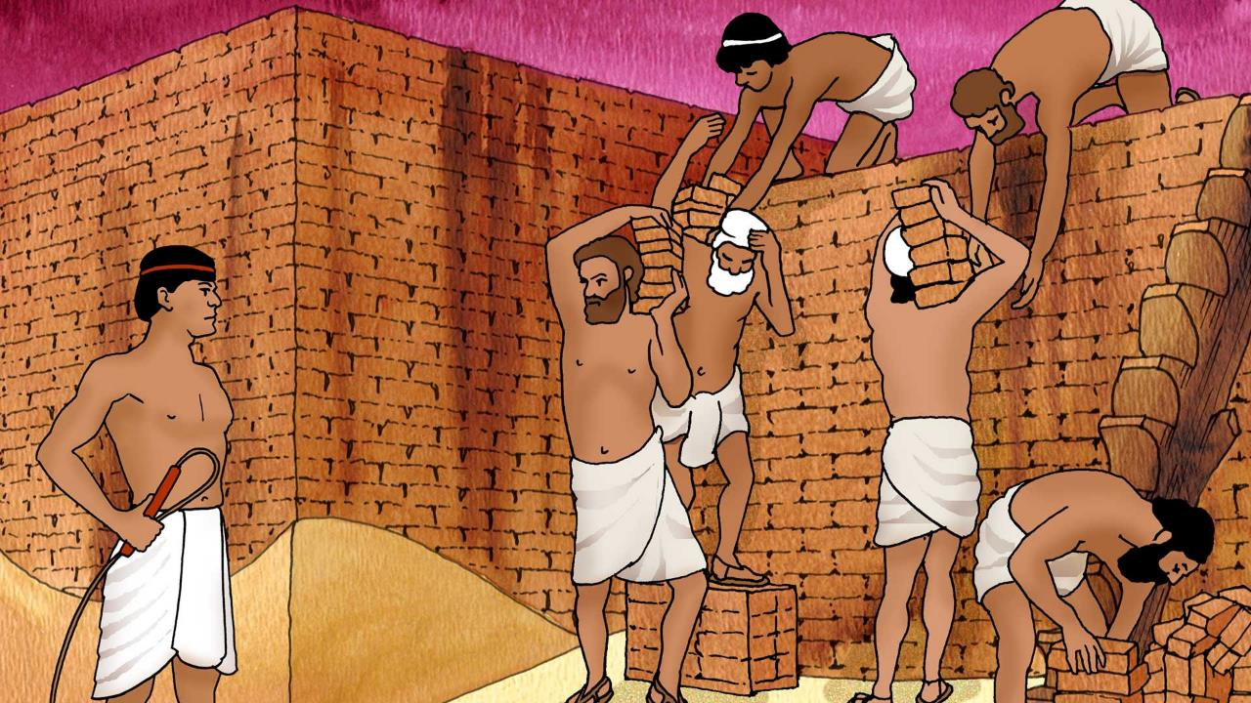
Notes:
The Lord said, ‘I have surely seen the affliction of My people who are in Egypt, and have given heed to their cry because of their taskmasters, for I am aware of their sufferings. So I have come down to deliver them from the power of the Egyptians...’ Exodus 3:7-8a (NASB)

Slide 4
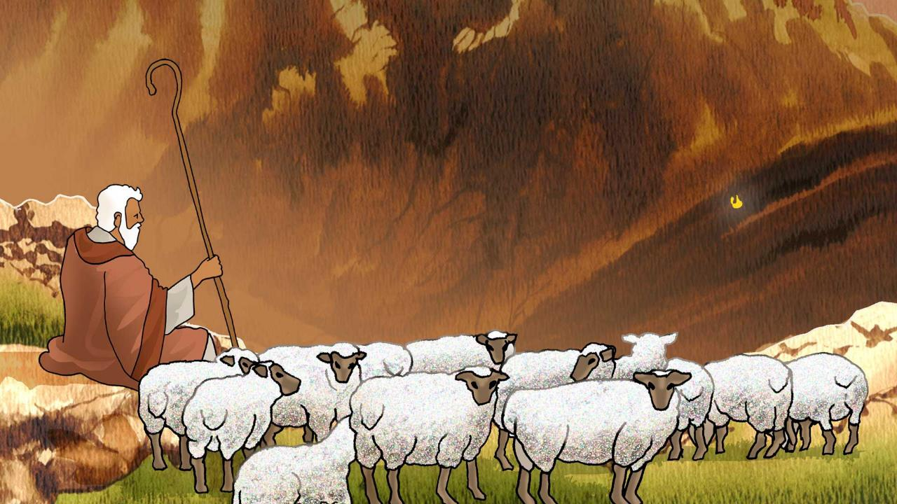
Notes:
After forty years as a shepherd, ‘... Moses was pasturing the flock of Jethro his father-in-law, the priest of Midian; and he led the flock to the west side of the wilderness and came to Horeb, the mountain of God.’ Exodus 3:1 (NASB)

Slide 5
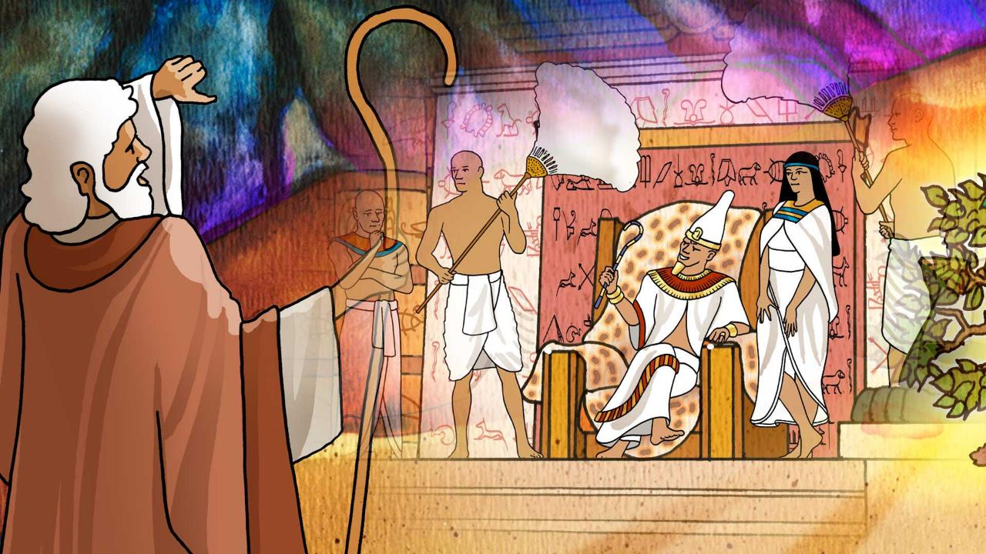
Notes:
God told Moses: ‘But I know that the king of Egypt will not permit you to go, except under compulsion. So I will stretch out My hand and strike Egypt with all My miracles which I shall do in the midst of it; and after that he will let you go.’ Exodus 3:19-20 (NASB)

Slide 6
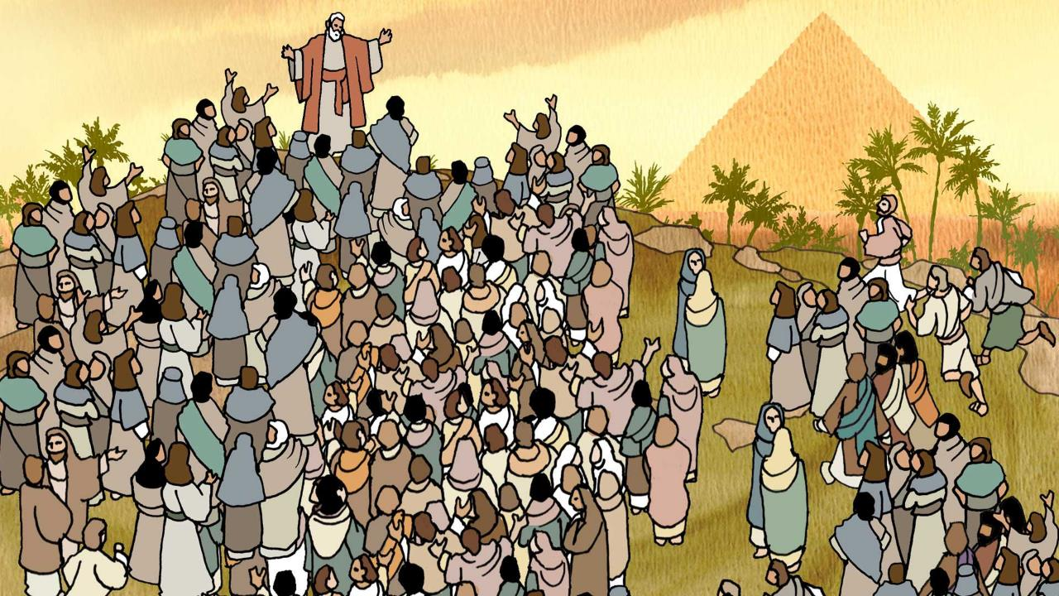
Notes:
Then the Lord said to Moses and Aaron in the land of Egypt, ‘This month shall be the beginning of months for you; it is to be the first month of the year to you.’ Exodus 12:1-2 (NASB). God gave directions to His people through Moses and Aaron so that this last plague would pass over and not harm them. Exodus 12:1-28 (NASB)

Slide 7
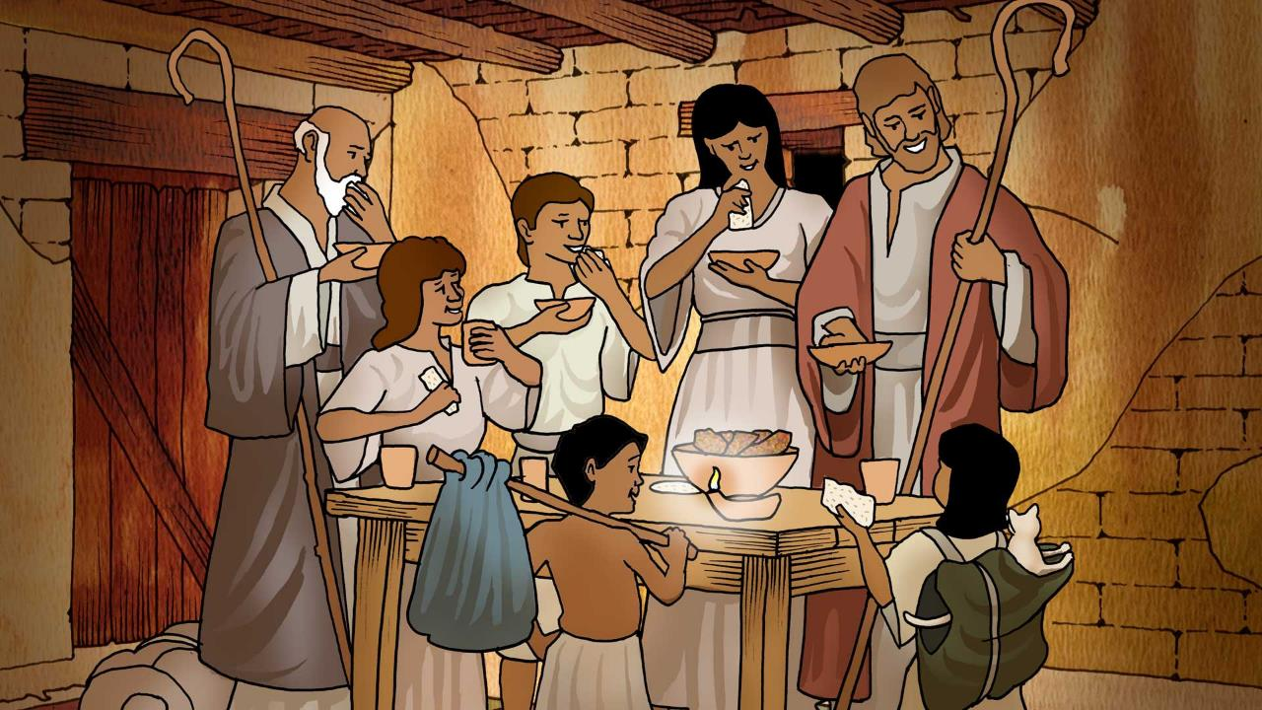
Notes:
‘And when your children say to you, “What does this rite mean to you?” you shall say, “It is a Passover sacrifice to the Lord who passed over the houses of the sons of Israel in Egypt when He smote the Egyptians, but spared our homes.”’
And the people bowed low and worshiped. Exodus 12:26-27 (NASB)

Slide 8
Do not be unkind to any foreign people who come to live in your land. Instead, treat them as well as you treat your own people and love them as much as you love yourself. Remember, you were once foreigners in the land of Egypt.
I am the Lord your God.
The Book of Leviticus 19:33-34

Slide 9
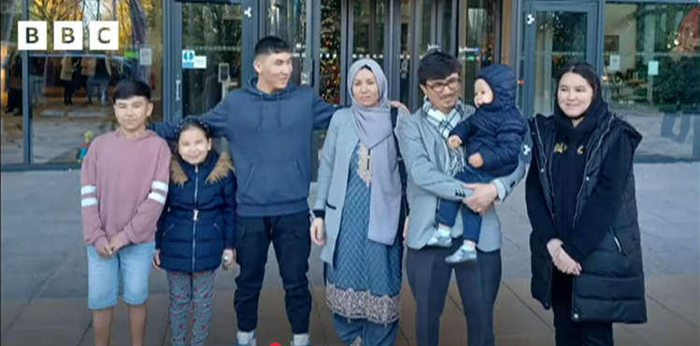

Slide 10
Jesus, friend and brother,
You know how it feels to leave your home and family,
To carry nothing with you, to travel as a stranger.
Help all refugees far from home, driven out by war and hunger.
Lead them safely on.
They are our sisters and brothers.
Inspire us to show our love and a true welcome.
Amen.

